Slide 1
Online and Mobile

Slide 2
Agenda
Online Ordering in our Markets
Order Flow Review
Mobile Focus

Slide 3
Online Ordering in our markets

Slide 4
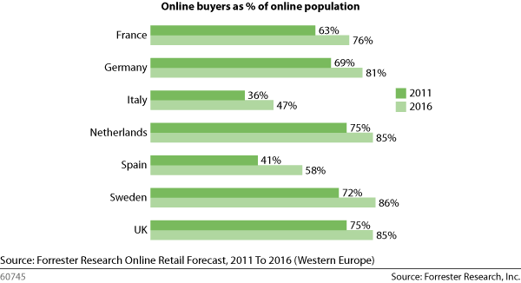
Europe eCommerce

Slide 5
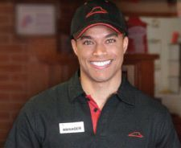
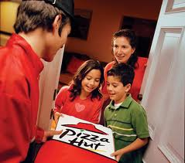
The Delivery Business Case
Call Center / Labor Savings
Higher Guest Check
Customer Satisfaction

Slide 6
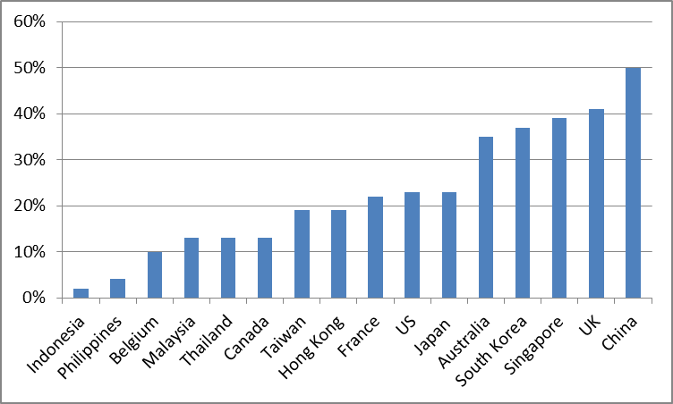
PH Online Mix
Notes:
HMR=Home Meal Replacement (delivery and carryout only) excludes dine in.
Best measure for our business as to how the digital teams are performing (web, email, etc)
Online sales rise and fall with offline
Increases in Online mix shows online outperforming offline

Slide 7
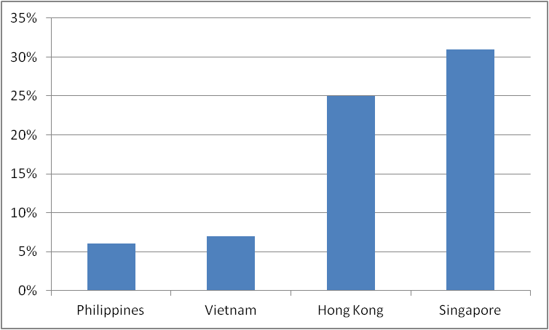
KFC Delivery Online Mix

Slide 8
Emerging vs Developed
Lessons apply to everyone
If starting, start off best in class
If established, improve on updates
Emerging markets
Expect lower mix initially
Beat competition to online (at least match)

Slide 9
Online ordering flow

Slide 10
Typical Online Customer Flow
Find a store
Select occasion and location
Select products
Checkout
Post Checkout
Requires cross-functional excellence!

Slide 11
Step 1: Finding our stores
Importance of search
Understanding how search works
Ideas to improve capabilities

Slide 12
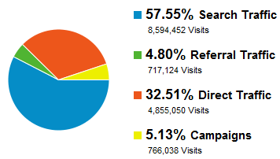
Search and Delivery Business
Search traffic can be critical part of our business
Optimized pages will result in more traffic to site
Should be monitored monthly

Slide 13
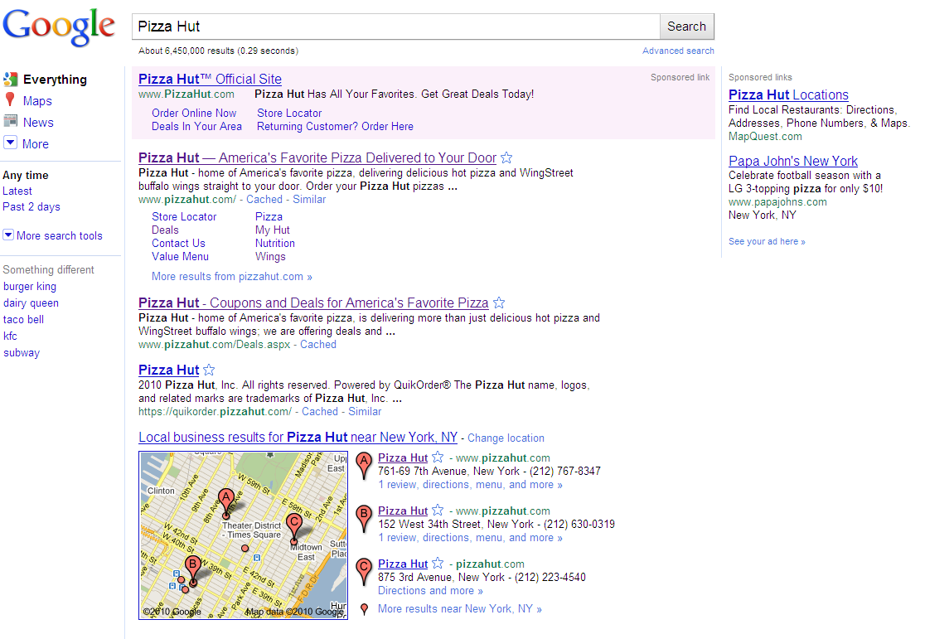
Anatomy of the Search Page
Sponsored Links Reach consumers at the moment they demonstrate interest
Sitelinks Help users navigate site
Natural Search Results generated algorithmically – unbiased and unpaid
Universal Search Maps, Images, Video
Notes:
Search engines are large databases created by ‘spidering’ the Web using search engine robots. These robots
are small pieces of software that follow links on the Web and record the content found at each URL. All this
content is then built into an index and made searchable by keyphrase or other quality.
As there are typically many millions of Web sites, pictures, or other types of content that may be relevant for a
typical user query, search engines spend most of their time creating scalable ways of ranking and ordering sites
in ways that users find helpful. Search engine optimization seeks to re-structure Web content to make it rank
better relative to competitors.

Slide 14
Bidding and Paying to Be Number One
Quality Score
x
Max CPC
=
Ad Rank
Ad Position
=
2.0
X
$0.50
=
1.00
…Position 1
=
1.0
X
$0.75
=
0.75
…Position 2
Pizza Hut is more relevant for users
But John Doe is willing to pay more
Pizza Hut wins position 1; Engines rewards relevance in combination with the bid, not the bid alone
Improving Quality Score is an effective way to raise ad position, while controlling costs
Notes:
Quality Score is determined by a combination of factors, including:
Click-through-rate
Keyword relevance
Ad text relevance
Landing page quality

Slide 15
Improving Quality Score
Prioritize Key SEO Pages
Branded Homepage
Product and Deal Pages
Store Landing Pages
Indexability
Text Stored as images are not indexed
Should have Alt text specified or have system text underneath images
See SEO Tips.pdf for more information

Slide 16
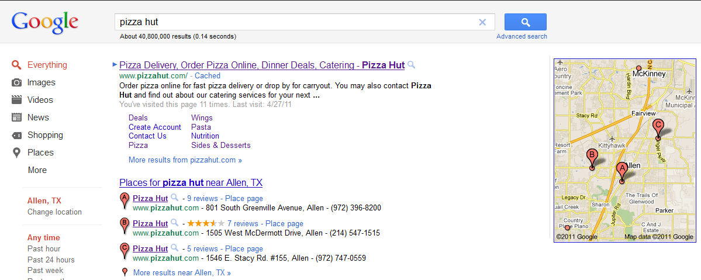
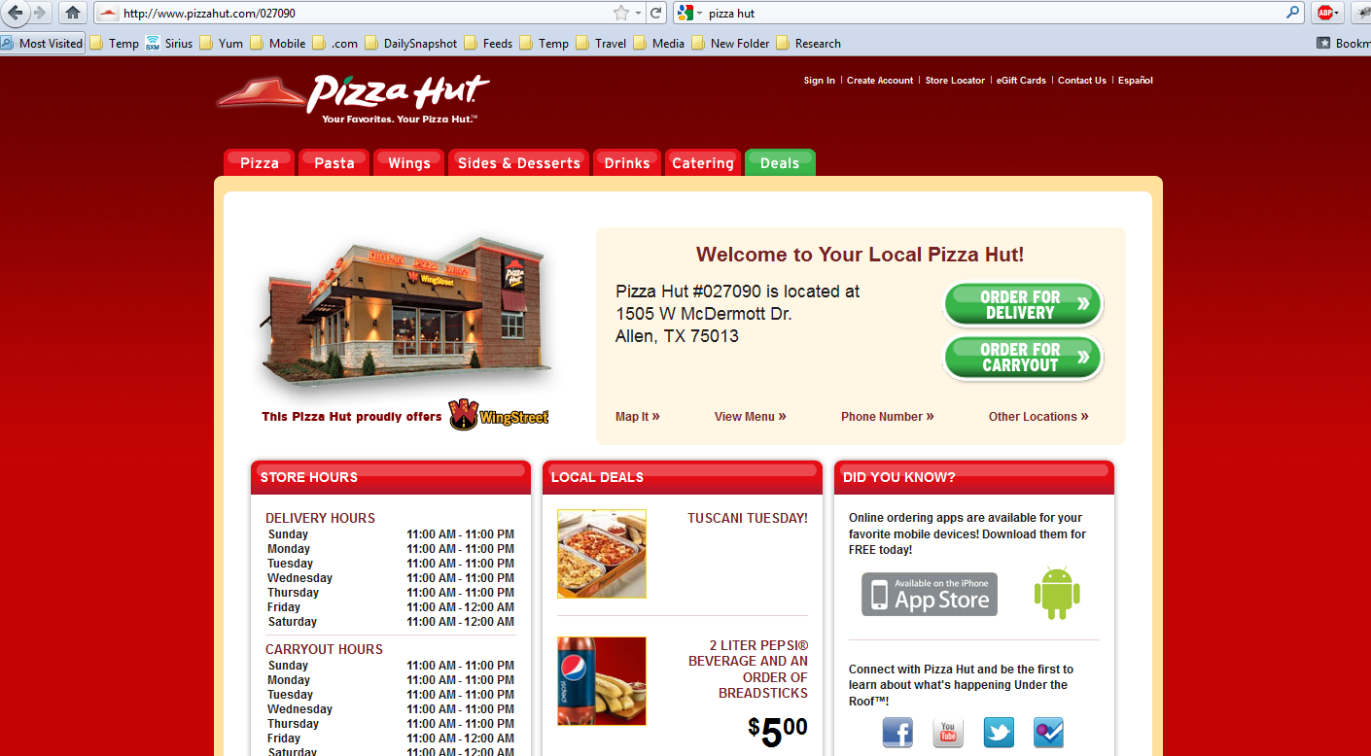
Store Landing Pages
Important organic landing pages for queries with a local or geographical component

Slide 17
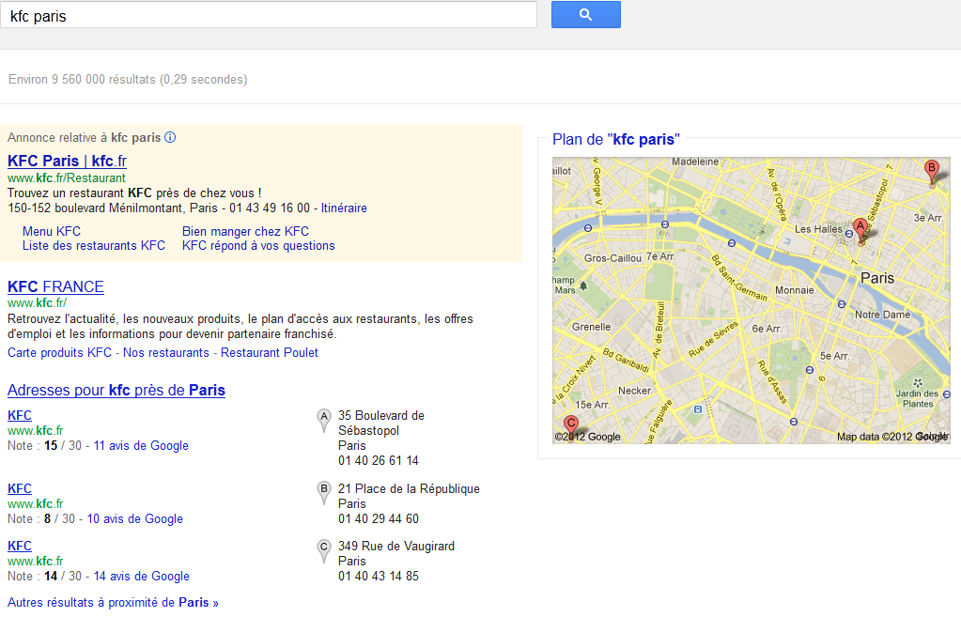
Google Places
Google Places\Plus

Slide 18
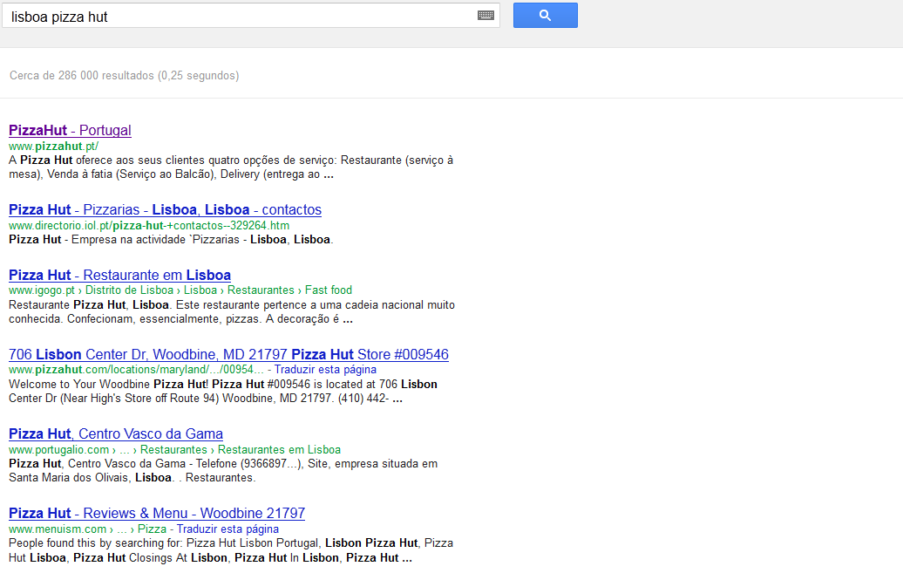
Opportunity

Slide 19
Key Lessons
Economical ways of improving search relevance through quality of page
Google Places are important
Store landing pages can improve relevance

Slide 20
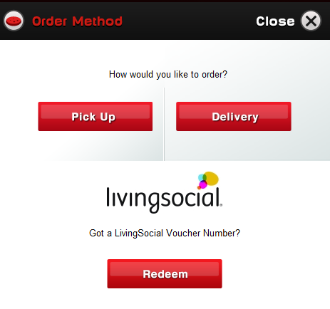
Step 2: Occasion and Location
Phone orders typically ask 1 thing after greeting:
“Will this be for delivery or take away”
No use taking order intent if not in trade zone
Online flow should be similar
Menus, prices, and offers may vary from store to store

Slide 21
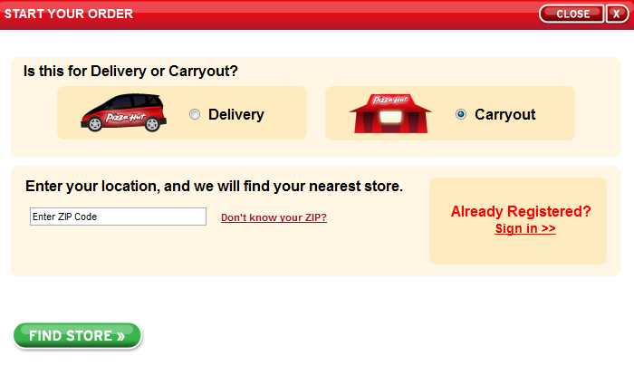
Carry out can be generic

Slide 22
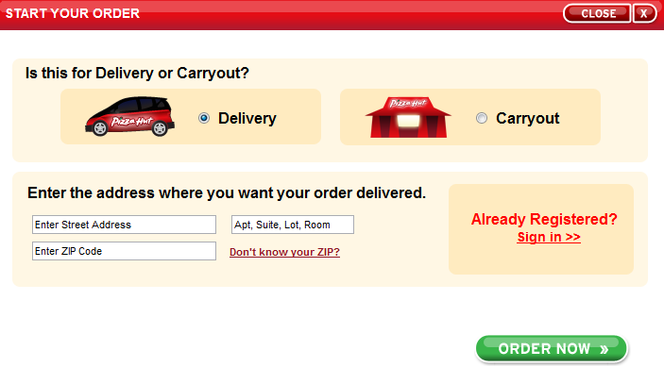
Delivery requires precision

Slide 23
Key Lessons
Occasion is critical to the shopping flow
Offer different paths
Ask only for necessary information
Potential to use digital mapping process to improve
US PH locations issues dropped 99%

Slide 24
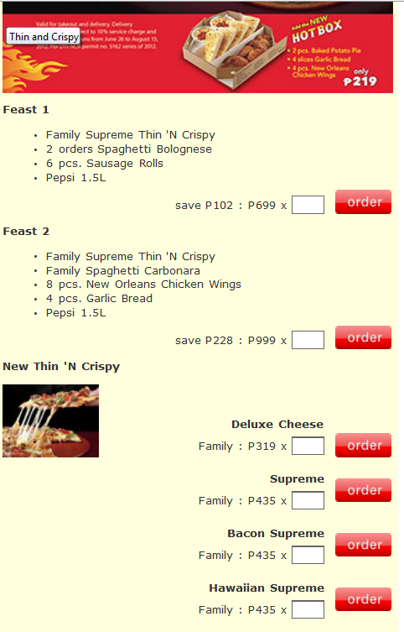
Step 4: Adding Product
Minimize Scrolling
Short pages convert better than long pages
Consider anchors (bookmark within a page)

Slide 25
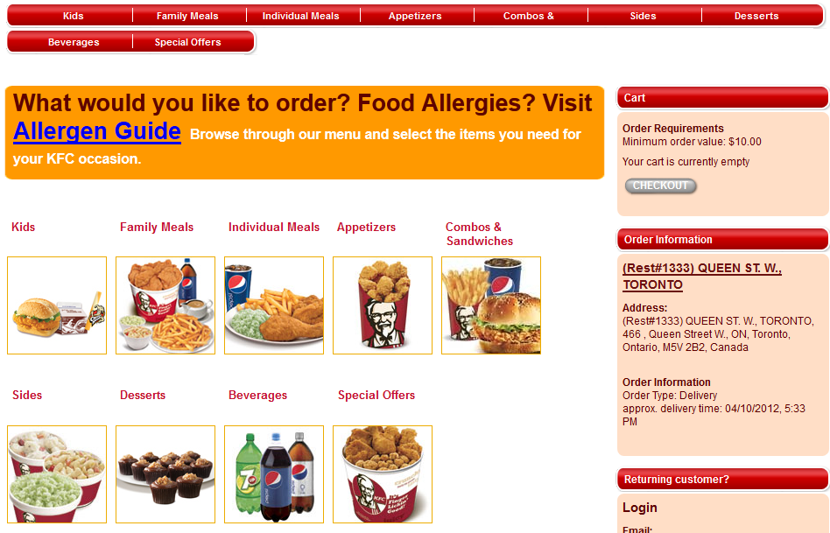
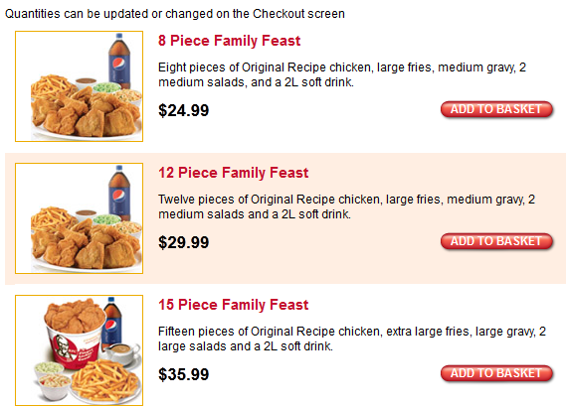
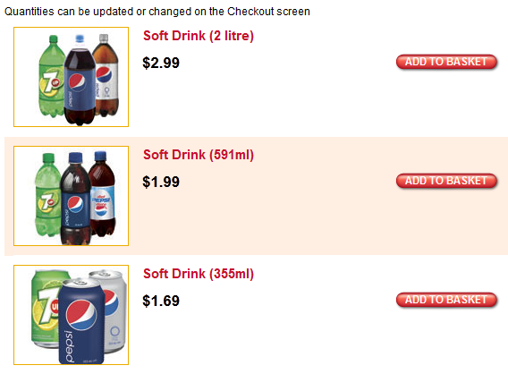
Consider product categories
Fewer is better
Easier to navigate
Easier to find product

Slide 26
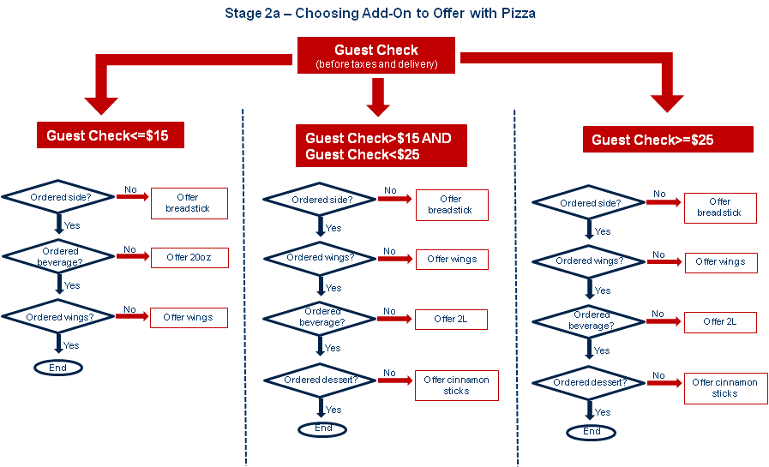
Increasing Guest Check
Popup upsell/cross-sell work in our category
Conditional logic can result in bigger gains
US PH saw 1.5% gain of SSSG in online tickets
See “Smart Suggestive Selling Rules.pdf”

Slide 27
Key Lessons
Avoid long forms when possible
Leverage product category pages/sections
Upsell/Cross-sell is very effective in generating higher Guest Check
Over 1% SSSG possible with logic

Slide 28
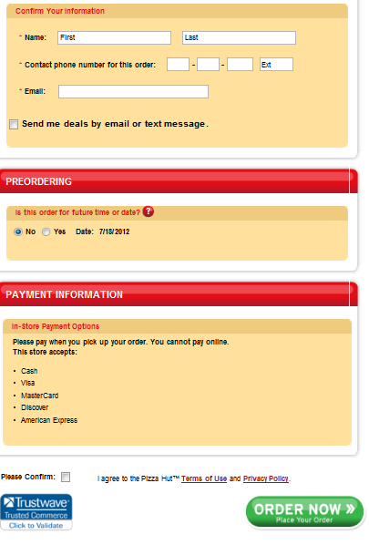
Step 4: Checkout
Simplify to only essential steps
Reduce distractions to focus user on placing order
Security Assurance helps persuade some 1st time customers

Slide 29
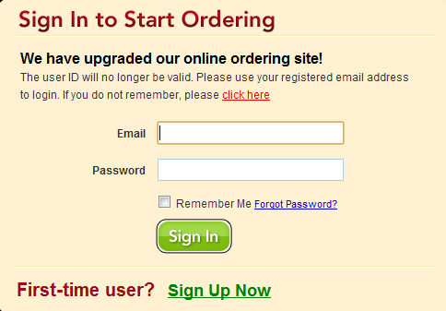
Consider Guest Checkout Flow
Forced registration is #1 reason for abandonment
Challenge the reasons why forcing registration
Market results:
US: 60% of orders
Canada: 50% of orders
UK: XX% of orders in 30 days

Slide 30
Resist Too Much Information
Every click is an opportunity to lose sale
Marketing information can be collected after the sale
Best Practice: How much information does a phone order need?

Slide 31
Key Lessons
Checkout abandonment can be minimized with simple easy process
Separate the need for marketing data from purchase elements

Slide 32
Step 5: Post Checkout
Great opportunity to gather more information
Order Confirmation Page and Email are prime
Ask customer to register for easier ordering
Pre-fill fields with known info
Conduct guest survey on ordering flow or service
Offer social links as process likely positive

Slide 33
Other Recommendations
Monitor page load time
Every 2 seconds of load time = 8% abandonment rate
Consider Gomez to monitor performance of key pages/processes
Can leverage Yum! scale to monitor
Test on popular browsers
Track browser popularity in your market
Test for top 2-3

Slide 34
Mobile Focus

Slide 35
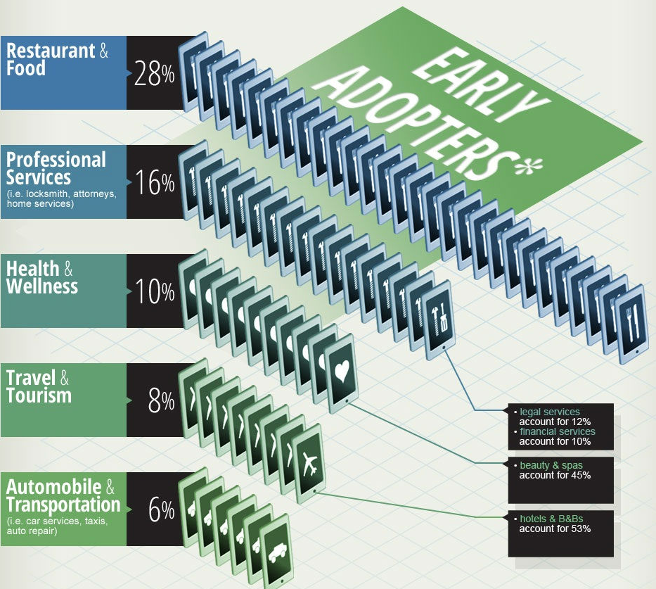
Mobile Opportunities
Our category is leading in mobile apps and sites
Google: 30% restaurant searches are done on mobile
Spiked up to 62% on Valentines Day in US

Slide 36
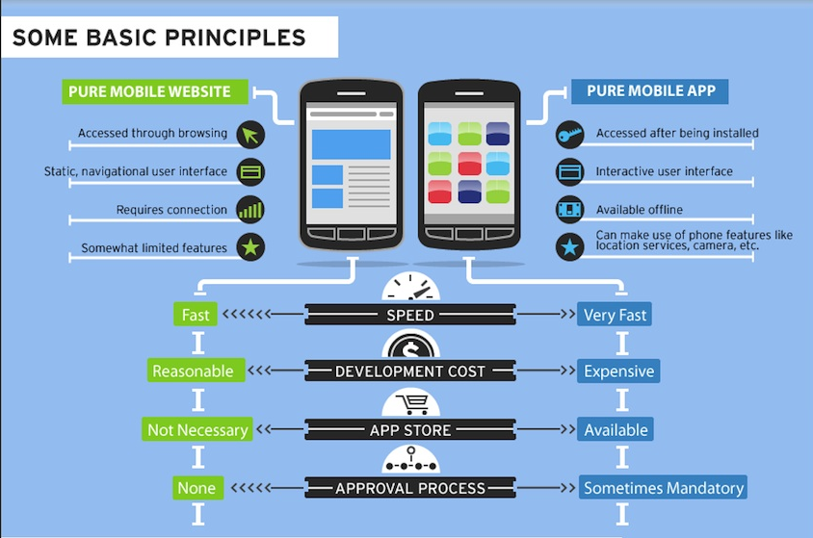
App vs Mobile Website Differences

Slide 37
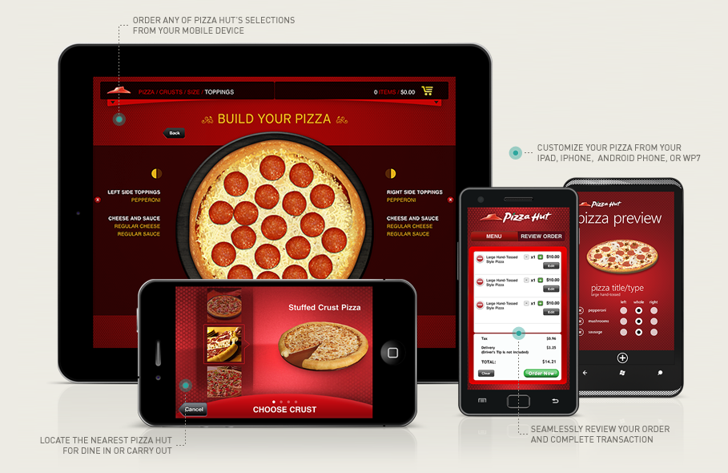
PH Leads Mobile Category in US
Designs available at : http://www.yumiching.com/groups/2012-global-digital-summit-cascade

Slide 38
Evolution of PH US Strategy
Launch of Mobile Site Ordering
Full menu
Requires username/password.
Cannot register on mobile
Launch of iPad, Android
Full menu
Guest ordering enabled
Included iPhone update
Jan 2008
Jun 2009
May 2011
Sep 2011
Launch of iPhone Ordering
Limited menu
Includes game
Requires username/password.
Can register for account
Mobile Site Update
Guest Ordering Enabled

Slide 39
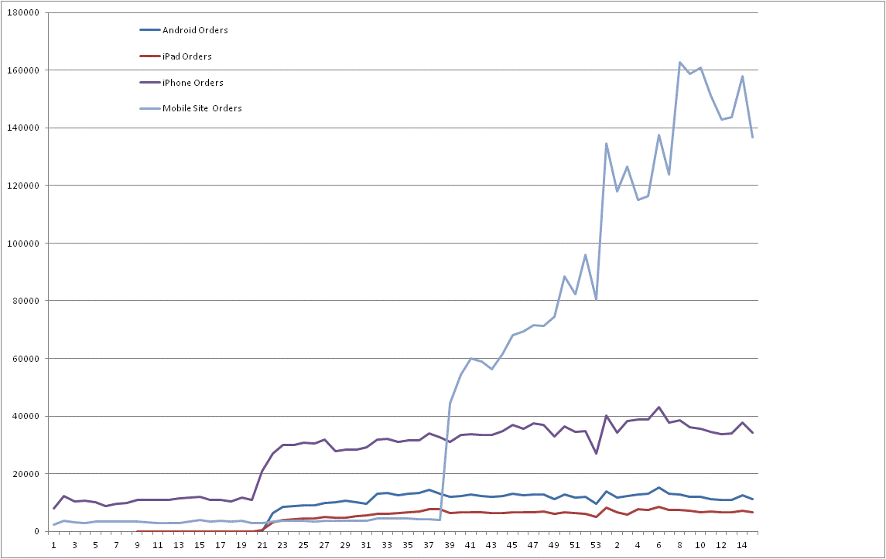
US Mobile Site Outperforms
No marketing of mobile site
2011
2012

Slide 40
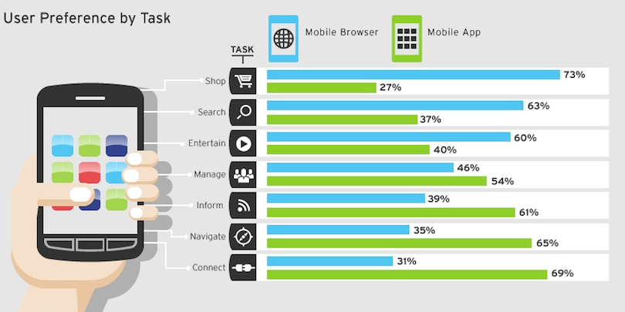
Not Just Pizza

Slide 41
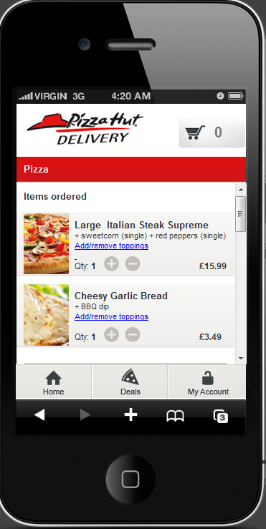
UK PH Mobile Site Now Live!
Features
No account needed
Vouchers and Deals
Location Services
HTML5
Launched 8/1
30% mix in 30 days!
Developed by UK Firm: Bemoko
Designed by UK Firm: Linney
Design available at:
http://phdmobile.digital.linneydesign.com/

Slide 42
Australia and others
Shared infrastructure with Canada, Romania, and India
Share cost to develop mobile site
Pay minimal localization fee to launch
Future GOE customers launch with web + mobile
Features
Based on PH US success
No account needed
Dynamic menu
Deals and Vouchers
Ready Nov 2012

Slide 43
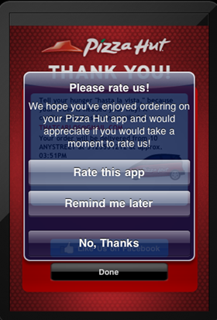
Improve App Ratings
Ask users to rate app after order confirmation
Higher likelihood of positive experience
PH US apps all have 4 star+ ratings!

Slide 44
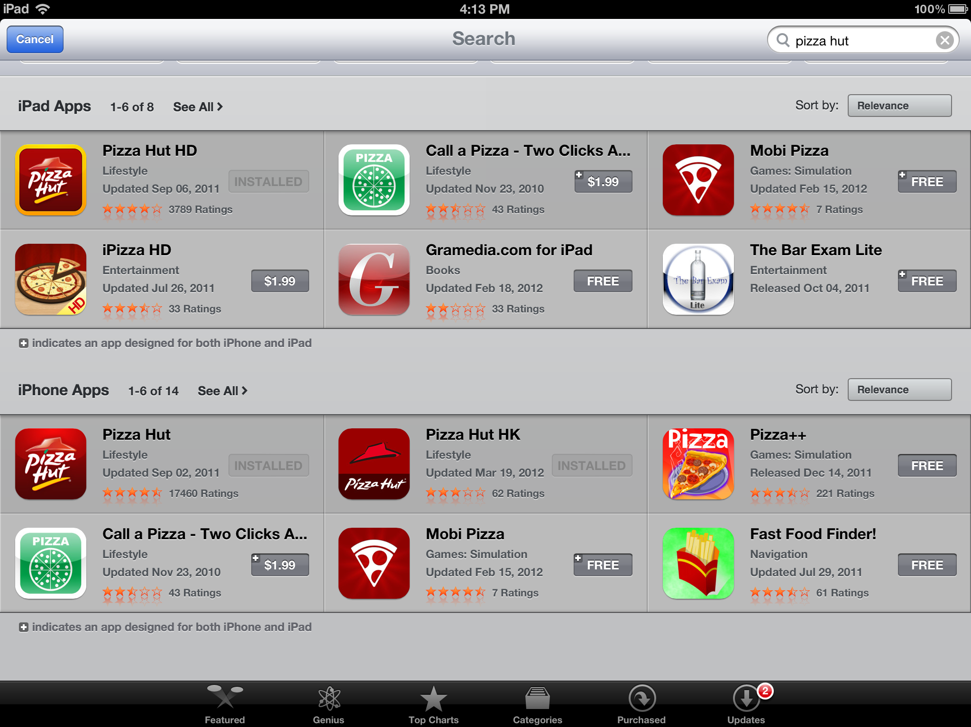
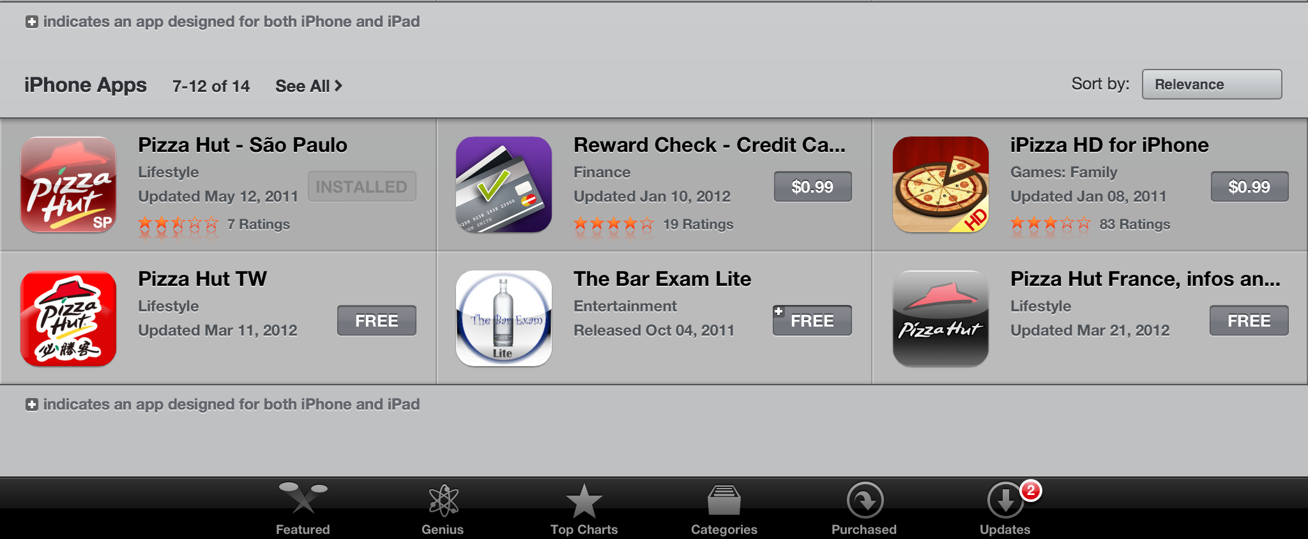
Apple App Store Opportunity
Currently at least 5 markets have apps available in the app store
Request to publish only in Country Market
Align with host country if need to publish in different app store

Slide 45
Lessons Learned
Mobile and restaurants go together
Prioritize mobile website ASAP
Apps average ~ 8% (of digital)
Mobile website – 25% (of digital)

Slide 46
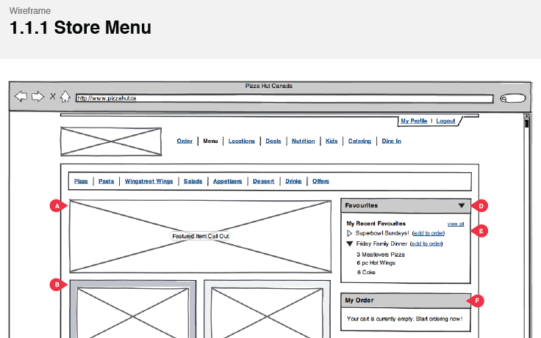
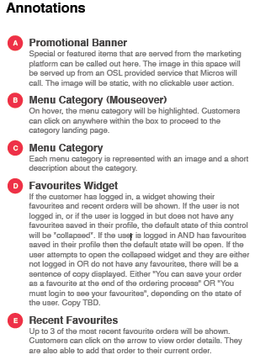
Know How Sharing
Leverage structured design process
Wireframes
Content guide
US PH designs are available to all

Slide 47
Session Summary
Optimize pages for search
Over 50% of traffic can come from search
Review user experience and look for improvements
Guest user flow: 50% customers prefer
Checkout process
Consider Digitized Trade Areas
Prioritize mobile friendly site vs apps
Source of over 25% of digital orders

